Slide 1


Analyze
NYSE Data
Business Analytics Nanodegree
Project 2
Done by: Zahra Maher Alnamer

Slide 2
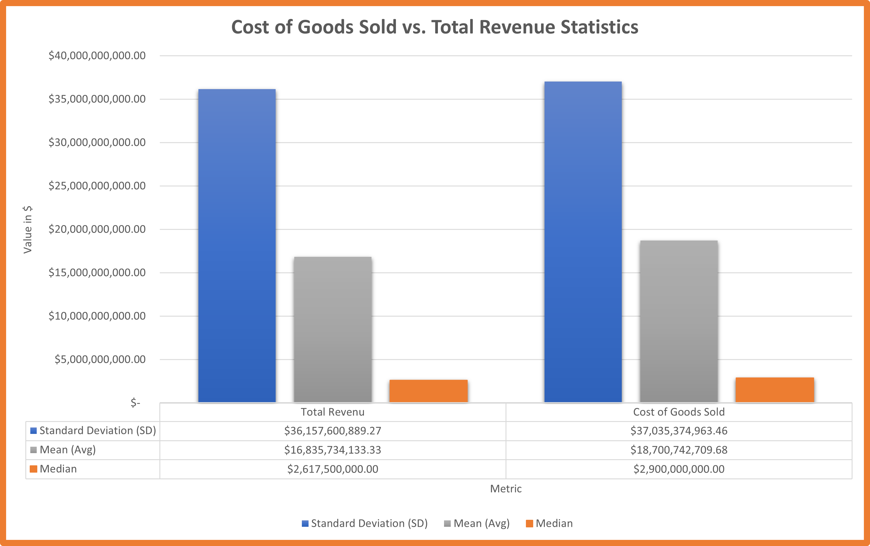
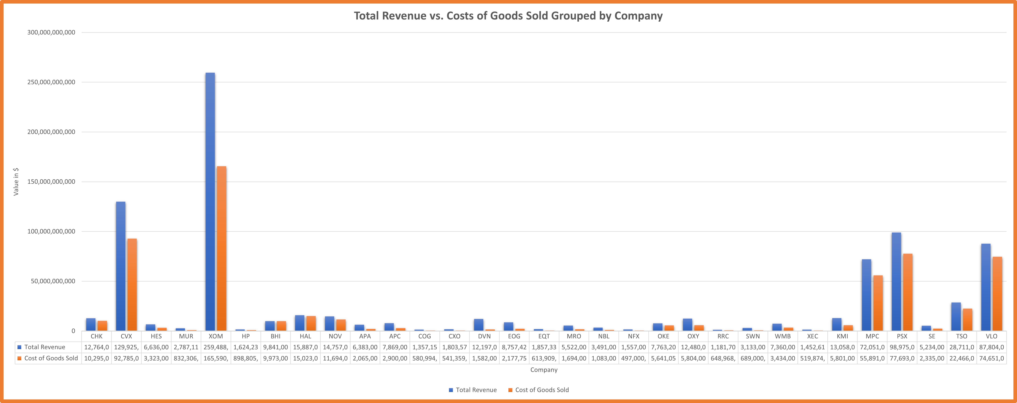
How Are the Profits of Energy Companies Compared to Their Expenses in the 4th Year?
The chart above shows the Cost of Goods Sold vs. Total Revenue statistics in All Energy Companies in Year 4. We can see that the Mean of Costs of Goods Sold ($18 Billion) is greater than the Mean of Total Revenue ($16 Billion) which is meaning that some companies are in not a good situation and they may lose as their Costs are near their total revenue. Also, we can notice that directly from the Standard deviation of the Cost of Goods Sold ($37Bilions) is higher than the standard deviation of total revenue ($ 36 Billion), which means some of the companies in a high risk. However, since we have the median less than the mean in both Costs of Total Goods and Total revenue, then we have fewer companies that have higher gross profits, but most of the company’s gross profit is near to its costs.

Slide 3
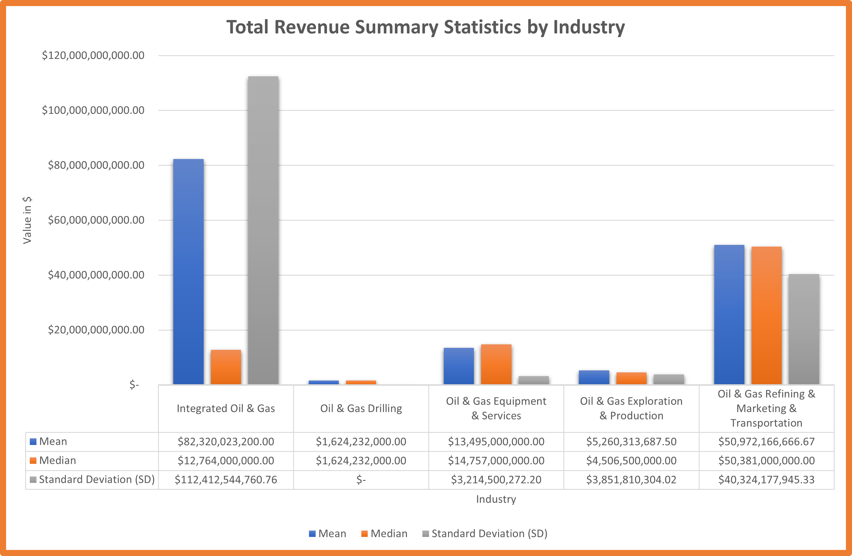
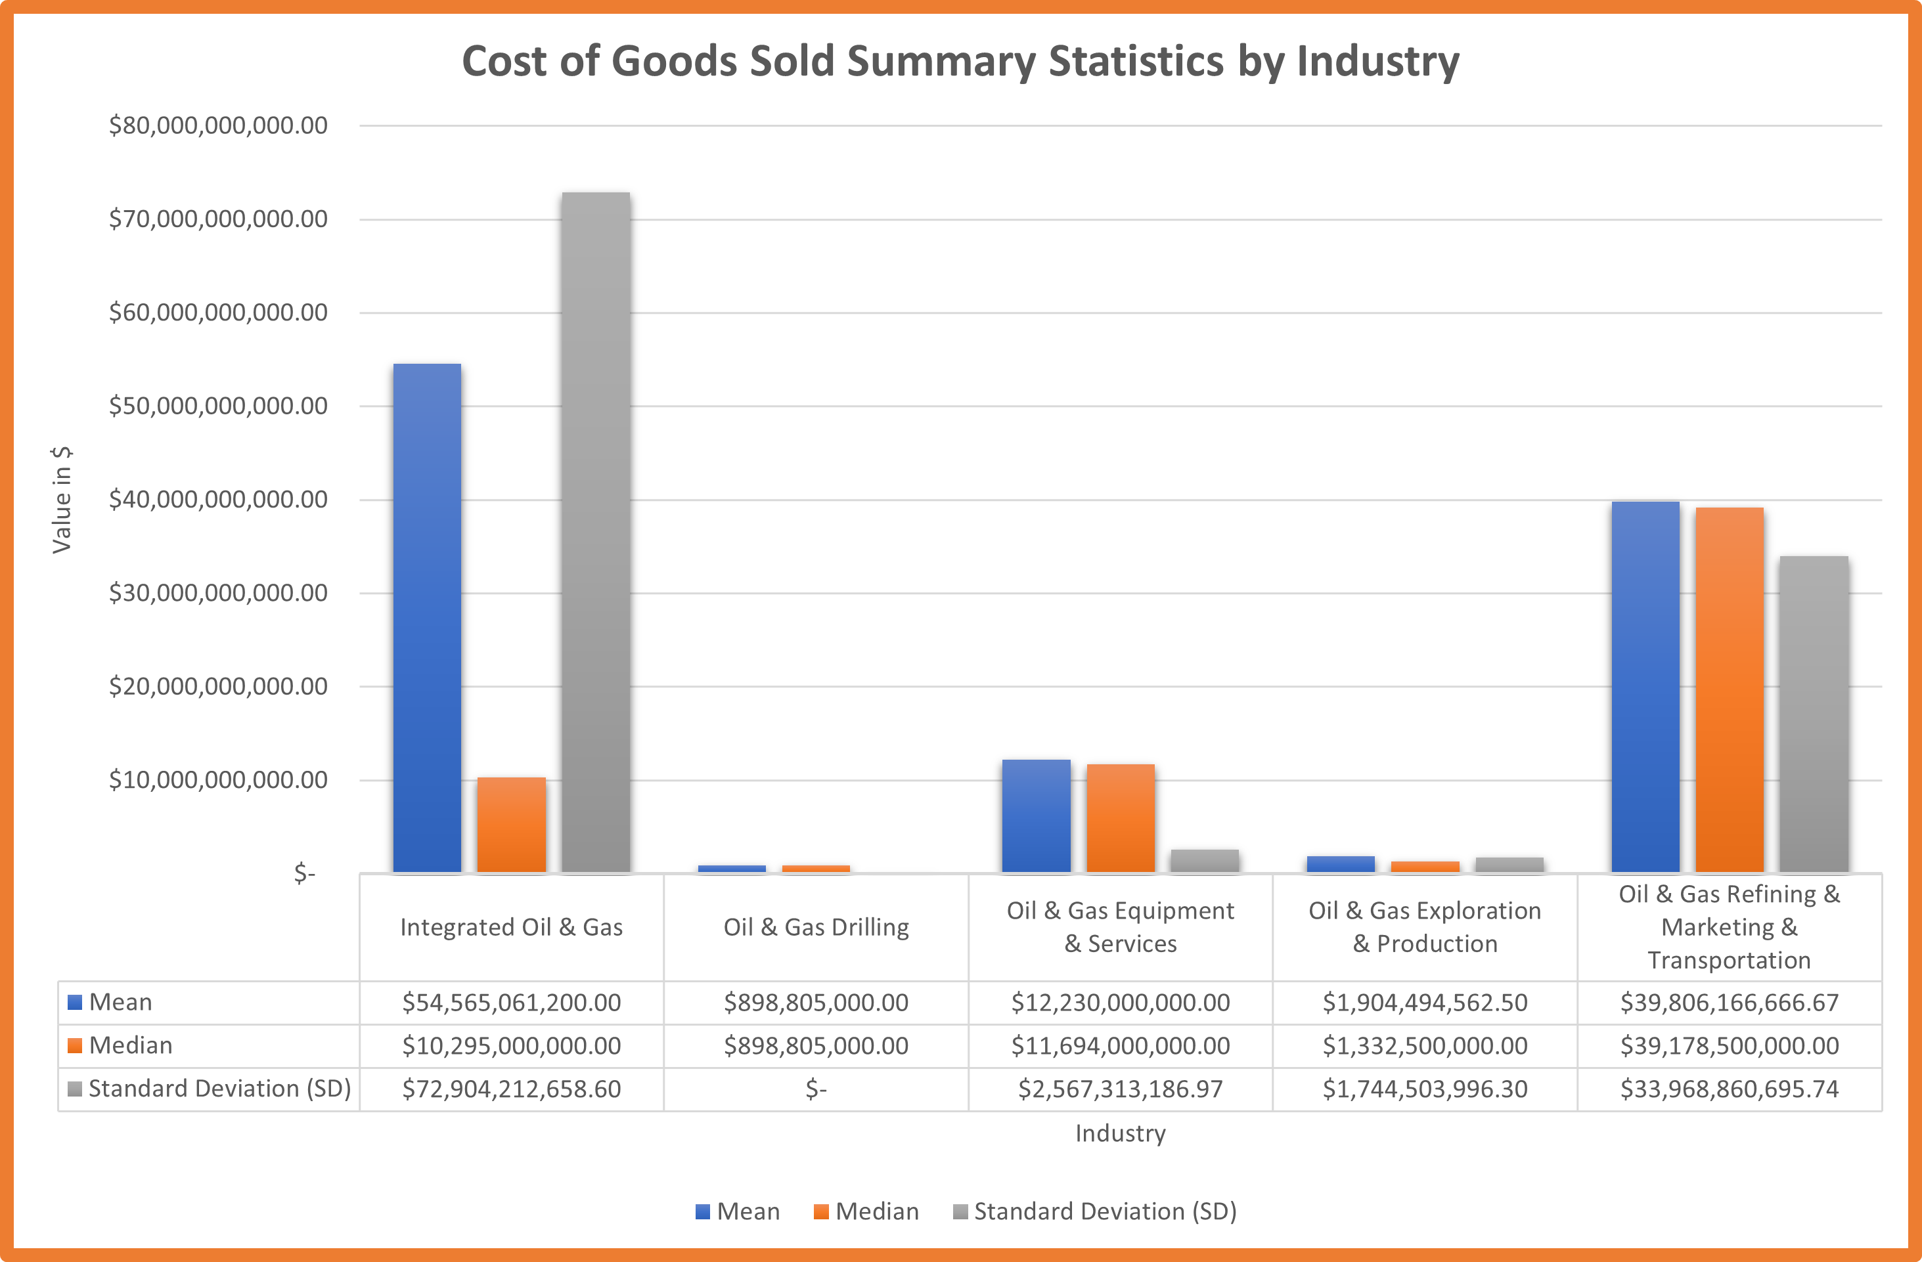
What are the best-performed company industries of Energy Companies in Year 4?
We can see that the Mean of Total Revenue for Integrated Oil & Gas Industry Companies ($42 Billion) is the highest but since there is a high standard deviation of ($112 Billion), so it makes its status unstable. We can prove it when we see that the Mean of Costs of Goods Sold for the Integrated Oil & Gas Industry ($52 Billion) is higher than the mean for the total revenue.
In another hand, the Mean of Total Revenue for Oil & Gas Refining & Marketing & Transportation Industry Companies ($50 Billion) compared to the Mean of Costs of Goods Sold for the Integrated Oil & Gas Industry ($1 Billion) is higher than the mean for the total revenue, has higher gross profits with no big gap between the mean and standard deviation, so we can consider it as best performed.
Note: We have ignored the Oil and Gas Drilling Industry because it is only 1 company in the population (Data Set), so we can make a good analysis with it.
Where the Mean of Total Revenue for Oil & Gas Refining & Marketing & Transportation Industry Companies ($50 Billion) compared to the Mean of Costs of Goods Sold for the Integrated Oil & Gas Industry ($1 Billion) is higher than the mean for the total revenue, has higher gross profits with no big gap between the mean and standard deviation, so we can consider it as best performed.
Note: We have ignored the Oil and Gas Drilling Industry because it is only 1 company in the population (Data Set), so we can make a good analysis with it.

Slide 4
More NYSE Companies Details?
Let’s explore it on Excel Dashboards:
Click Here
Thank You

